Slide 1
Lagrange

Slide 2



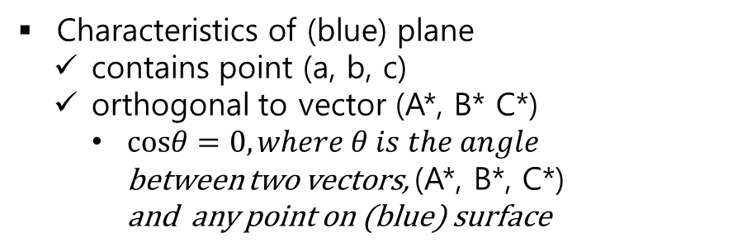

Prerequisite
Orthogonal Plane
$$z$$
(A, B, C)
Characteristics of (blue) plane
contains point (a, b, c)
orthogonal to vector (A*, B* C*)
$cosθ=0, where θ is the angle$ between two vectors, (A*, B*, C*) and any point on (blue) surface
(A*, B*, C*)
$$θ={90°}^{ }$$
=(A, B, C) - (a,b,c)
(a, b, c)
$$x$$
$$y$$

Slide 3

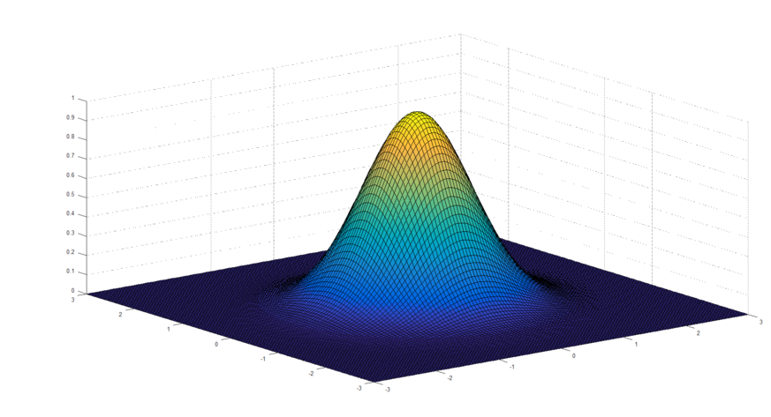
Prerequisite
When gradients are 0, value is maximized (or minimized)
https://blog.naver.com/lyb0684/221332307807

Slide 4
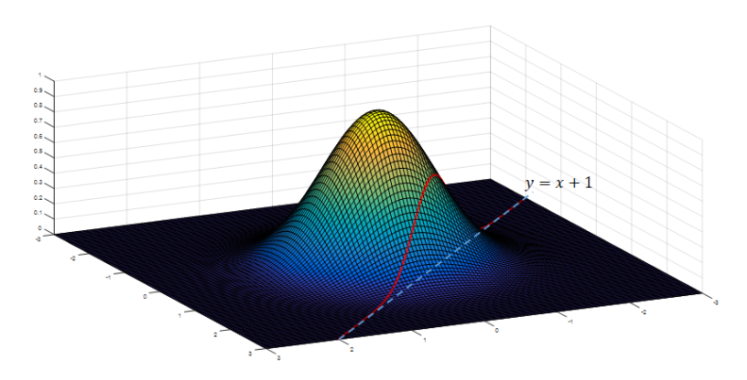
Question
Find maximum (or minimum) value of f(x) with constraint g(x) = 0
Constraint g(x) = 0
g(x) = y-x-1 = 0
this line contains all values of z axis
So this line (plane) has orthogonal (red) vector
https://blog.naver.com/lyb0684/221332307807

Slide 5


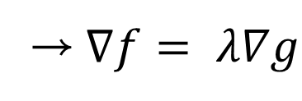
Lagrange Multiplier
"Maximizing (or Minimizing) f(x) with constraint g(x) = 0" is satisfied when two vectors of f(x) and g(x) has equilibrium power
Gradient Vector that maximize f(x)
$$∇f−λ∇g=0$$
→$∇f= λ∇g$
Therefore, we should satisfy all this equations
Orthogonal Vectors of plane
Bussotti, P. (2003). On the genesis of the Lagrange multipliers. Journal of optimization theory and applications, 117(3), 453-459.

Slide 6
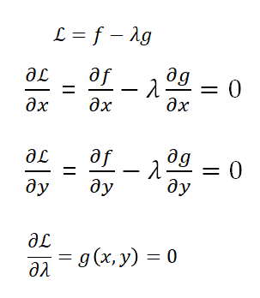
Lagrange Multiplier
"Maximizing (or Minimizing) f(x) with constraint g(x) = 0" is satisfied when two vectors of f(x) and g(x) has equilibrium power
$$∇f−λ∇g=0$$
Lagrange formulate problem as below:
→$∇f= λ∇g$
Therefore, we should satisfy all this equations
https://blog.naver.com/lyb0684/221332307807

Slide 7
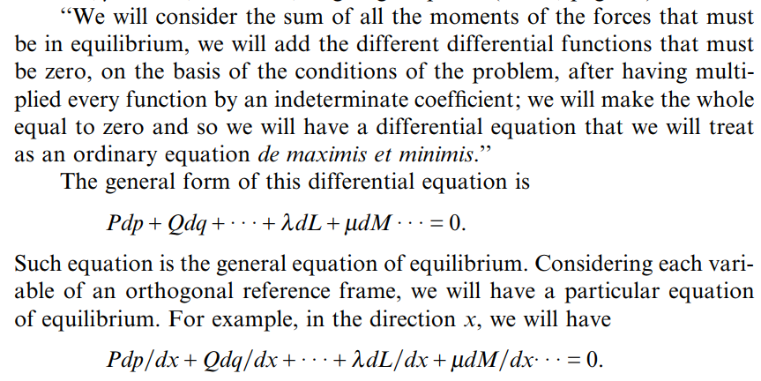
Further Constrains
Bussotti, P. (2003). On the genesis of the Lagrange multipliers. Journal of optimization theory and applications, 117(3), 453-459.

